Slide 1


School of Computer Science & IT Department of BCA
INTRODUCTION TO LINUX(20BCA1C06)
MODULE 1: INTRODUCTION TO LINUX COMMANDS
Faculty : Dr. Ananta Ojha

Slide 2
Session -7
Commonly Used Commands
Working with Files
Creating Links
Changing File Permissions

Slide 3
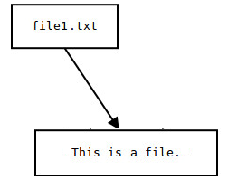
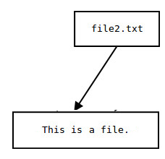
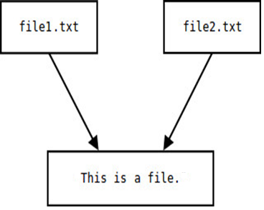
Creating File Links: ln
Copy
When a file is copied both the original and the copy occupy separate disk spaces for file data. The Linux system allows you to maintain a single copy of the data with more than one file name called links. If you change the contents of the data pointed to by either one of these files, the other file's contents are changed as well. In case of hard link, if you remove one file, the actual data is not removed, the link is removed. Links can be hard or soft link. In case of soft link, if you remove original file, the actual data is removed, the link file can’t find the data.
ln: create link
Syntax: ln original_file link_file
Example: Create a link for file1 and name it as file2 in current working directory.
$ ln file1 file2
Example: Create a link for file3 and name it as file4 in a directory dir1 using –d option.
$ ln –d file3 dir1
Example: Create a symbolic / soft link for file11 and name it as file12 in the current directory.
$ ln –s file11 file12
Link

Slide 4
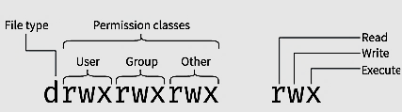
Changing File Access Permission: chmod
Category | Operation | Permission / Attribute
u - user g - group o - others a - all | + assign permission - remove permission = assign absolute permission | r - read w - write x - execute
Syntax: chmod <category> <operation> <permission> <filename(s)>
Example: To enable all user to execute a file either of the following
$ chmod ugo+x file1
$ chmod a+x file1
$ chmod +x file1
Example: To remove write permission from both group and others
$ chmod go-w file2
Example: To assign execute permission to user, and remove read permission from others ( use multiple permissions separated by comma)
$ chmod u+x,o-r file3
Example: If you want to assign only read permission to both group and others, and remove all other permissions, then you can use absolute permission
$ chmod go=r file4

Slide 5
Octal Notation for chmod
Permission | Value
Read Write Execute | 4 2 1
When there is more than one permission associated with a particular category, the respective numbers are add.
Example: if a file has read and write permission for the owner, then the octal representation of the permission will be 4 + 2 = 6. If the same permission is also repeated for the group and others, then it will be a three digit number for the category
$ chmod 666 file5
Example: Assign all permissions to all categories
$ chmod 777 file6
Example: Remove all permissions from all categories.
$ chmod 000 file7

Slide 6
Directory Permissions
File permissions can be changed for directories similar to files.
Example: Remove executable permission for all of a directory
$ chmod 666 myprogs
Permission | Meaning
Read | Allows file names in the directory to be read. You can use ls command to list out its contents. If read permission is removed, then ls command will not work.
Write | Allows entries to be modified within the directory. You can create and remove files. In the absence of write permission, you can’t create or remove files.
Execute | Allows to pass through the directory in searching subdirectories. You need to have execute permission for each of the directories in the pathname. In the absence of execute permission, you can’t use cd command. You can’t execute the files inside the directory.

Slide 7

THANK YOU Any questions…?

